Slide 1

Introduction to Standardised
Characterisation Studies in DARWIN EU
Dani Prieto-Alhambra
Deputy Director, DARWIN EU

Slide 2
Disclosure
This whole workshop and all the included presentations represent the views and knowledge of the presenters (members of the DARWIN EU® Coordination Centre) and cannot be interpreted as reflecting those of the European Medicines Agency or the European Medicines Regulatory Network.

Slide 3
THE CHALLENGE: Scaling up the generation of Real-World Evidence (RWE)
Real-World Data (RWD): routinely collected data relating to patient health status or the delivery of health care from a variety of sources other than traditional clinical trials
Real-World Evidence (RWE): information derived from analysis of real-world data
RWE for regulatory purposes needs to be:
Fast, transparent, scalable and reproducible
Representative (of EU regions)

Slide 4
Generating Reliable Evidence using the OMOP Common Data Model
We need to make studies repeatable, reproducible, replicable, generalisable, and robust
B
B
C
Reliable evidence
Patient-level data in source system/schema
C
L
K
L
A
K
Patient-level data in CDM
A
D
D
E
E
Q
M
J
F
J
F
O
G
G
I
H
I
H
A Common Data Model enables standardised analytics to generate reliable evidence.

Slide 5
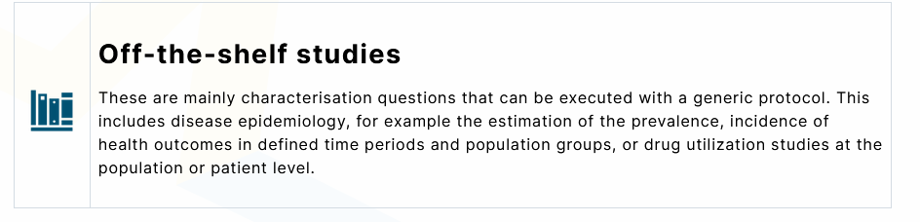
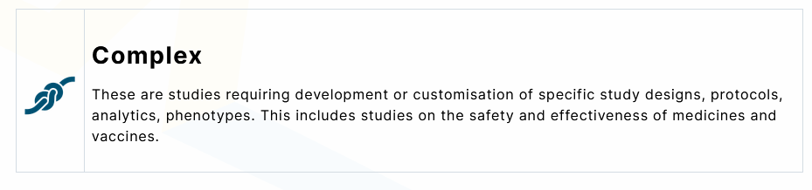
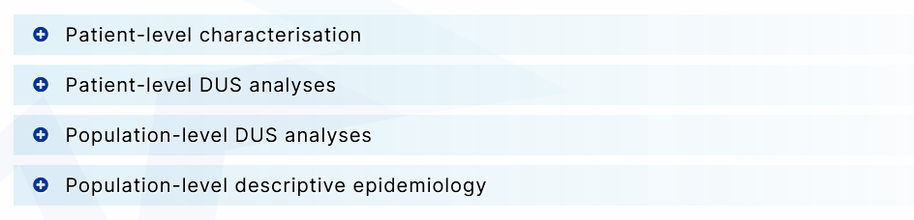
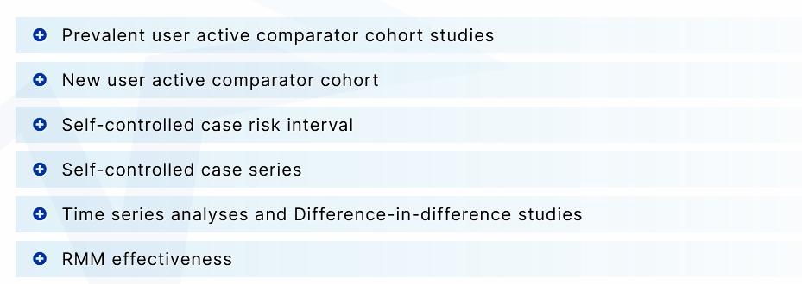
Catalogue of Standard Data Analyses

Slide 6
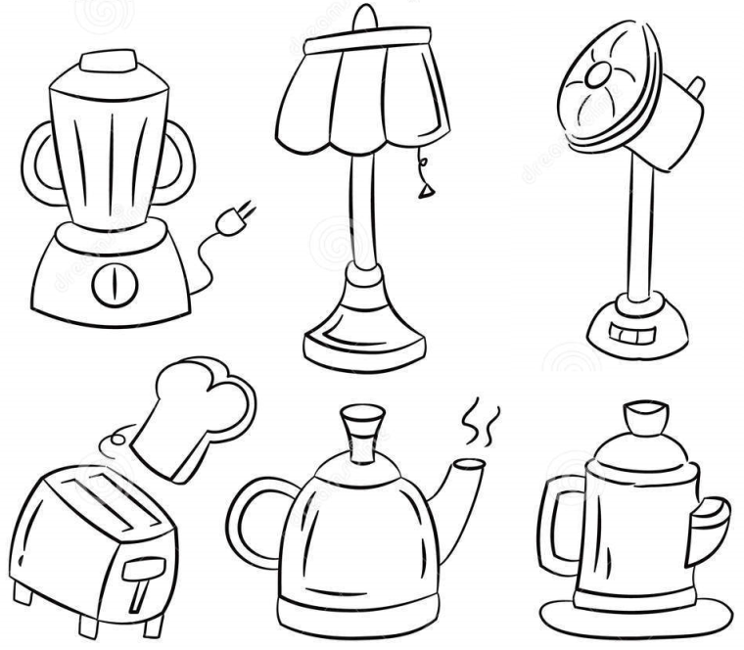

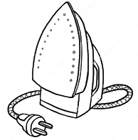
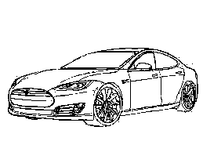
From Data Standardization To Standardised Analytics
Drug Utilisation
Disease Epi
Drug Safety
Spain Italy NL
US Claims UK Japan India
Vaccine
Effectiveness
DK Sweden Estonia Czech
Standardized analytics
Standardized data
6

Slide 7
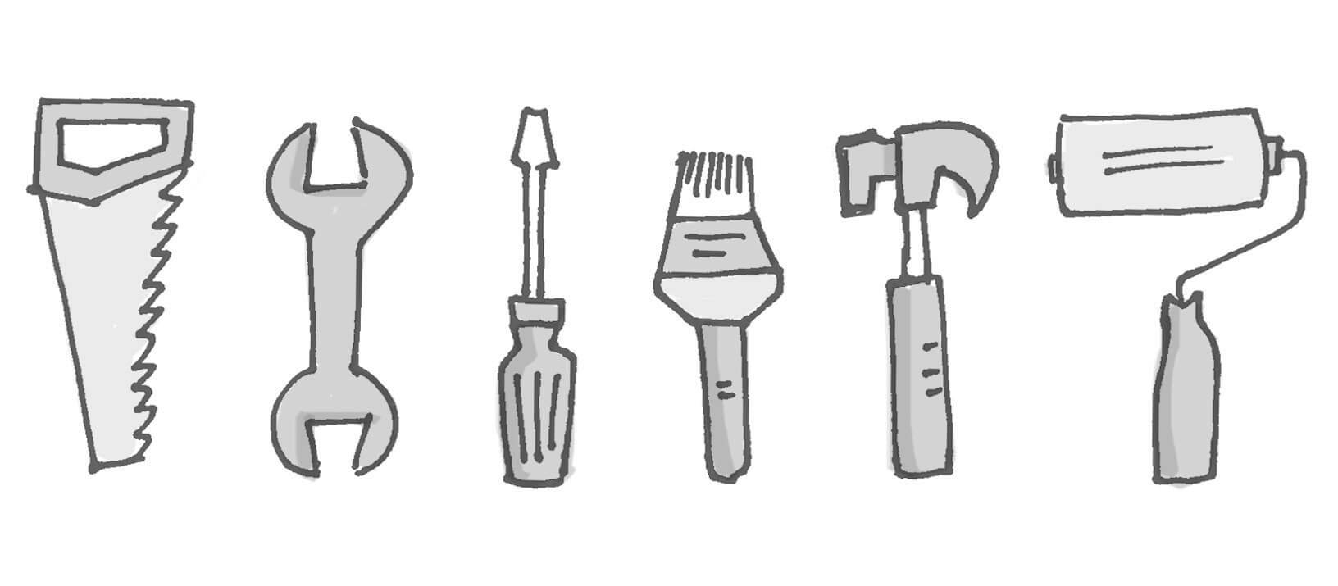
Building tools
Primary focus of the development pillar is providing tools (mostly R packages) to help users to perform standard data analyses, and training to facilitate the use of the resulting tools

Slide 8
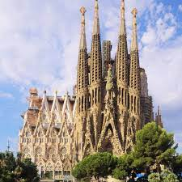
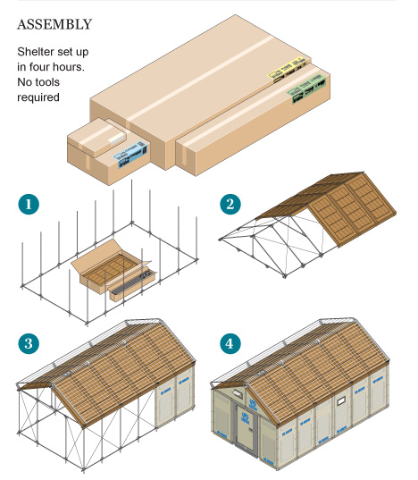
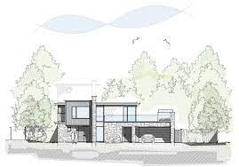
Hacking a hard problem: Scaling up
Off the shelf
Fully STD
Complex
Pre-specified
(some bespoke)
Very complex
Bespoke code

Slide 9
Draft Catalogue of Standard Analyses: Off-the-shelf studies and examples
Standard Analysis | Regulatory example
Population-level disease epidemiology | Prevalence of rare disease/s Background rates of AESI or DMEs
Patient-level disease epidemiology | Natural history/prognosis Current practice/treatment patterns
Population-level DUS | Incidence and prevalence of use of medicine/s over time
Patient-level DUS | Describing indication/s for drug/s Treatment duration, cumulative use

Slide 10
Building the tools: Developing OMOP-Std Analytical Pipelines
TODAY …

Slide 11
OtS Characterisation in DARWIN EU®
Study Design
Cohort analysis
Participant/s
Cohort/s newly diagnosed with 1 or more pre-specified condition/s
+ with some amount of data visibility before diagnosis
+ no record of the same condition/s in the previous year (or in all previous history)
Additional eligibility criteria could apply

Slide 12
OtS Characterisation in DARWIN EU® (2)
Follow-up
From their date of new diagnosis (index date) until the earliest of:
loss to follow-up,
end of data availability,
a pre-specified time period (e.g. 1 year after index date)
or death (or exit date)

Slide 13
OtS Characterisation in DARWIN EU® (3)
Analyses
Automated large-scale characterisation, including all recorded baseline characteristics available in the data before or on index date
Pre-specified patient-level characteristics on and/or before index date, based on pre-existing phenotypes (e.g., history of type 2 diabetes, or Charlson comorbidity index)
Incidence rate/s of pre-specified outcome/s within a time period (e.g. 1 year)

Slide 14
OtS Characterisation in DARWIN EU® (4)
Analyses
Survival / progression to a pre-specified outcome within a pre-specified time, e.g., cumulative incidence of certain events or death within 1- or 5-years after dgn
Standard care description, aka Treatment patterns including:
n (%) receiving each of a pre-specified list of medicine/s, device/s or procedure/s
+ combinations within a pre-specified time window

Slide 15
LEARNING GOALS TODAY
Learn how to use DARWIN EU® tools to:
Create a condition-based cohort
Characterise the resulting cohort
Study treatment patterns for subjects with the disease of interest

Slide 16
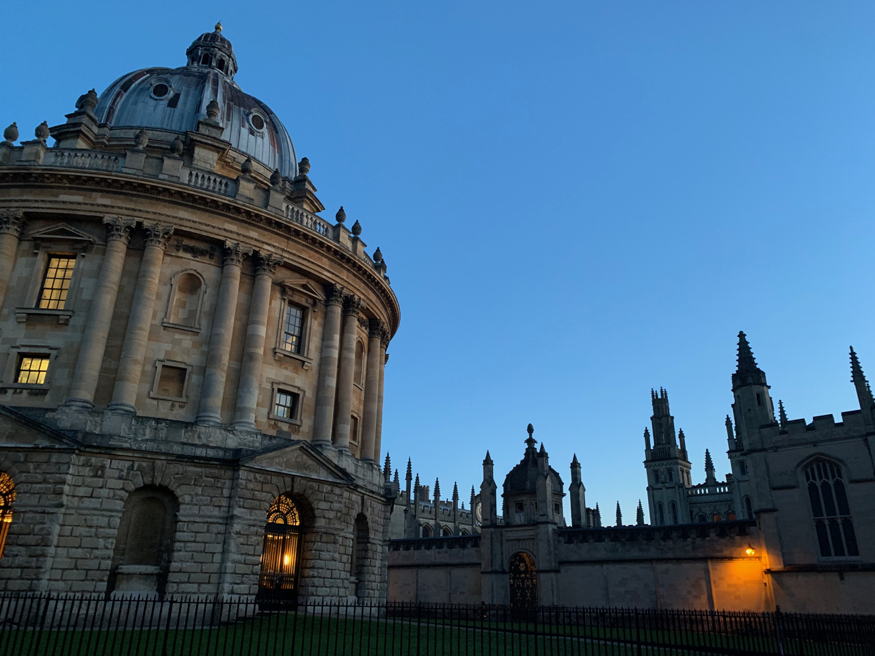
QUESTIONS?
d.prietoalhambra@darwin-eu.org

